Slide 1
19CS211 Computer Organisation and Architecture Session 4 (12-01-2021) Dr V Anantha Narayanan

Slide 2
Big / Little Endian

Slide 3
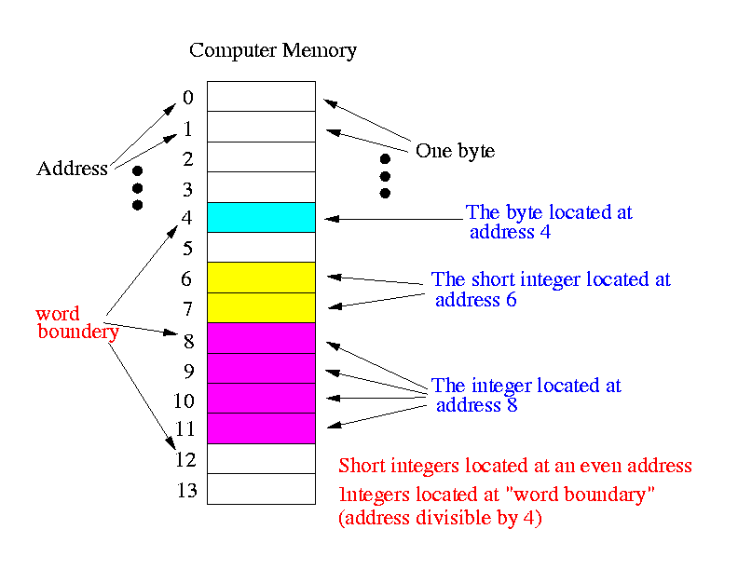

Slide 4
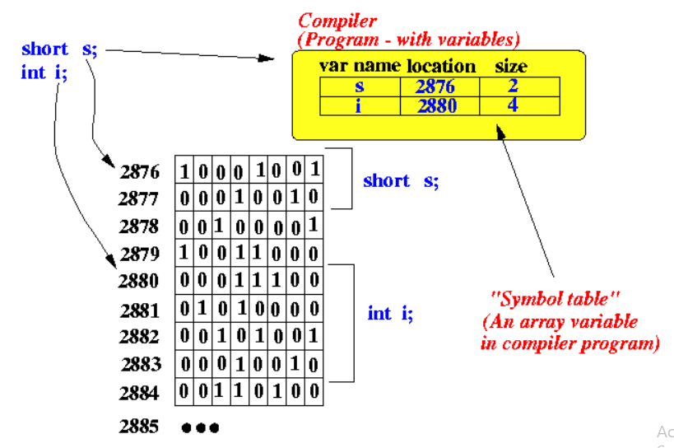

Slide 5
A load word or store word instruction uses only one memory address. The lowest address of the four bytes is used for the address of a block of four contiguous bytes.
How is a 32-bit pattern held in the four bytes of memory? There are 32 bits in the four bytes. A choice has to be made about which byte of memory gets what part of the pattern. There are two ways that computers commonly do this:
32-bit pattern 0x12345678 is stored at address 0x00400000. The most significant byte is 0x12; the least significant is 0x78.
Within a byte the order of the bits is the same for all computers (no matter how the bytes themselves are arranged).

Slide 6
Big Endian Byte Order: The most significant byte (the "big end") of the data is placed at the byte with the lowest address. The rest of the data is placed in order in the next three bytes in memory. 32 Bit data 0x12345678 and Address is 0x04000000
0x04000000 | 0x04000001 | 0x04000002 | 0x04000003
12 (MSB) | 34 | 56 | 78 (LSB)

Slide 7
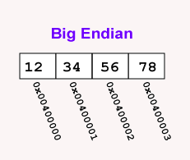
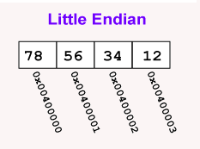
Little Endian Byte Order: The least significant byte (the "little end") of the data is placed at the byte with the lowest address. The rest of the data is placed in order in the next three bytes in memory. 32 Bit data 0x12345678 and Address is 0x04000000
0x04000000 | 0x04000001 | 0x04000002 | 0x04000003
78 (LSB) | 56 | 34 | 12 (MSB)

Slide 8
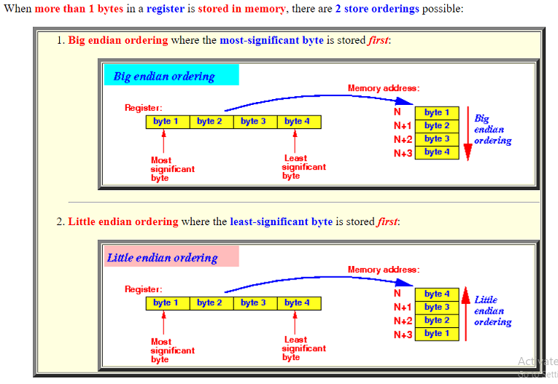

Slide 9
Which ordering is better ?
• The ordering has absolutely no effect of processor performance and any other performance factor.
As long as the processor retrieve the bytes stored in the memory in the same ordering as the processor stores the bytes, the load and store instructions will operate correctly and with the same efficiency

Slide 10
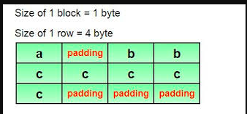
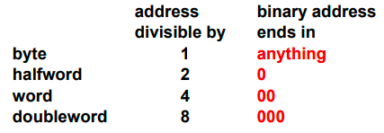
The endianness in use is determined by the CPU type.
For example:
The INTEL processors (x86) are little endian
The ARM processor is little endian by default; and can be programmed to operate as big endian
Many older processors were big endian, such as: Motorola M68000 and SPARC

Slide 11
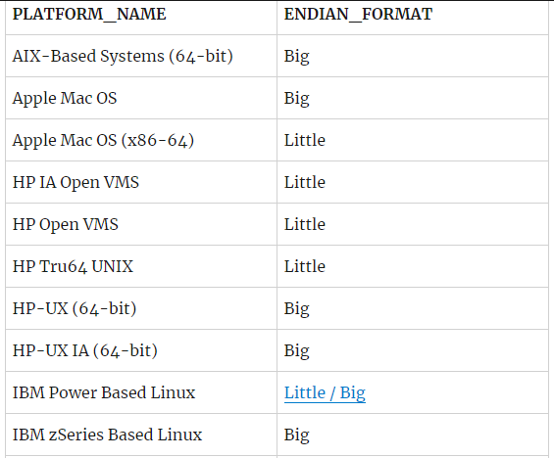
SQL> SELECT platform_name, endian_format
FROM V$TRANSPORTABLE_PLATFORM
ORDER BY PLATFORM_NAME;

Slide 12
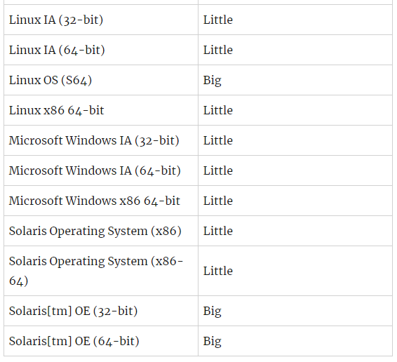

Slide 13
Big-endian CPUs order bytes within words so that the most significant byte is stored at the lowest byte address; little-endian CPUs, including IA-32 processors, use the opposite byte placement. When communicating across a network, it is possible that two machines may use different byte orderings.
To account for this possibility, the network byte order (which happens to be big-endian) is used by convention to send network data in a manner that will be received coherently, regardless of the endianness of the sender and receiver.

Slide 14
Sockets libraries provide helper functions to convert integers of various sizes to and from network byte order, as follows:
•htons(): host to network short
•htonl(): host to network long
•ntohs(): network to host short
•ntohl(): network to host long

Slide 15
The function htons() is one of a small family of functions, macros actually, that solves the problem of transferring binary data between computer architectures with different byte ordering policies. The Internet has established a standard “network byte order,” which happens to be Big Endian. All binary data is expected to be in network byte order when it reaches the network.
htons() translates a short (16 bit) integer from “host byte order,” whatever that happens to be, to network byte order.
There is a companion function, ntohs() that translates back from network byte order to host order. Then there is a corresponding pair of functions that do the same translations on long (32 bit) integers.

Slide 16
Performance Metrics

Slide 17
The speed of a computer processor, or CPU, is determined by the clock cycle, which is the amount of time between two pulses of an oscillator. Generally speaking, the higher number of pulses per second, the faster the computer processor will be able to process information. The clock speed is measured in Hz, typically either megahertz (MHz) or gigahertz (GHz). For example, a 4GHz processor performs 4,000,000,000 clock cycles per second.

Slide 18
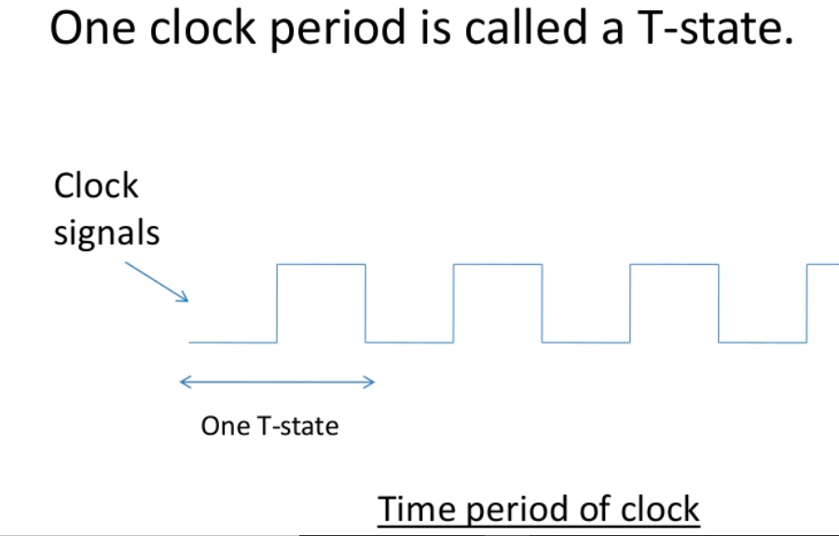

Slide 19
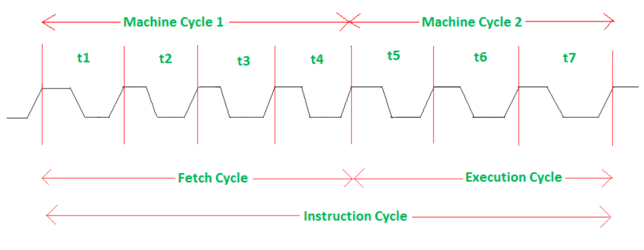
The time required by the microprocessor to complete an operation of accessing memory or input/output devices is called machine cycle.
One time period of frequency of microprocessor is called t-state.
A t-state is measured from the falling edge of one clock pulse to the falling edge of the next clock pulse. Here, Fetch cycle takes four t-states and execution cycle takes three t-states.

Slide 20
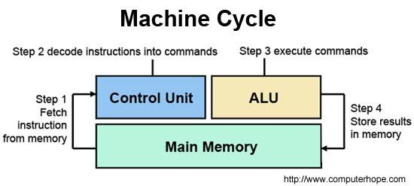

Slide 21
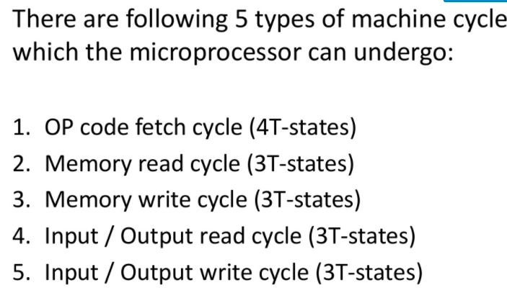
Four steps of Machine cycle
Fetch - Retrieve an instruction from the memory.
Decode - Translate the retrieved instruction into a series of computer commands.
Execute - Execute the computer commands.
Store - Send and write the results back in memory.

Slide 22
Instruction Cycle
The sequence of operations that the CPU has to carry out for execution of an Instruction is called instruction cycle.
1:- Read an Instruction
2:- Decode the instruction
3:- Find the address of operand
4:- retrieve an operand
5:- perform desired operation
6:- find the address of destination
7:- store the result into the destination

Slide 23
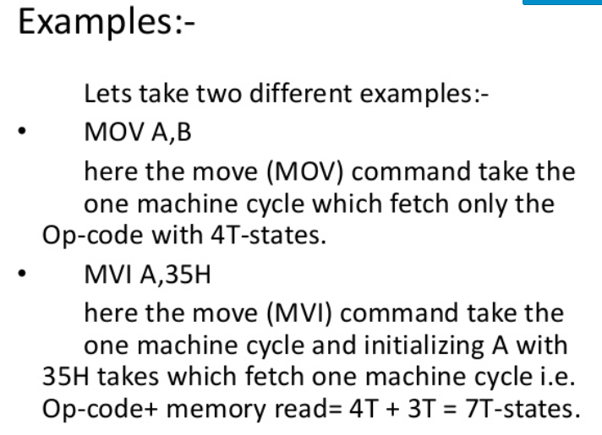

Slide 24
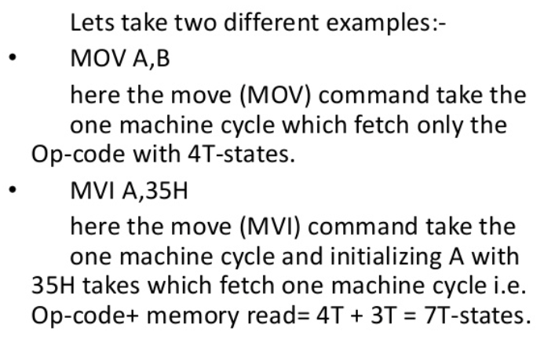
Examples

Slide 25
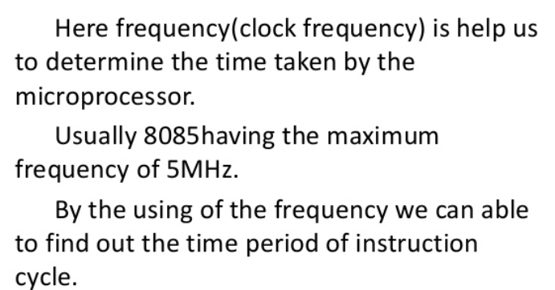
Frequency

Slide 26
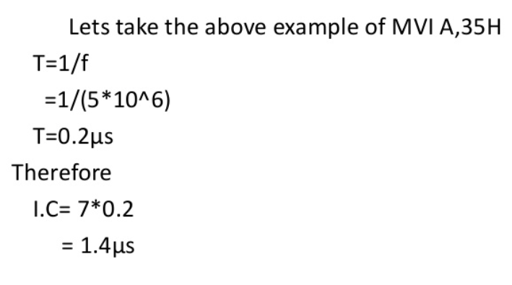
Example

Slide 27
Example
Assume machine A has 5MHz Crystal and Machine B has 10 MHz Crystal
What is the Time of T state in machine B
0.1uS
What is the Time taken by the Instruction MVI A, #35 in Machine B
0.7uS
Which Machine is having better performance
Machine B is having Better performance compared to Machine A

Slide 28
End of Session 4

